Slide 1
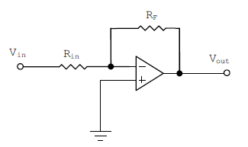



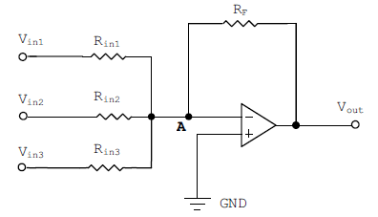
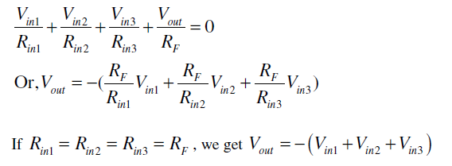
Inverting Amplifier
Sign Changer
Inverting Summing Amplifier

Slide 2
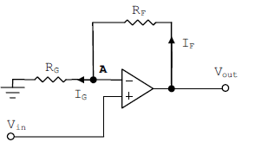

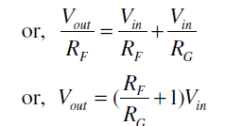
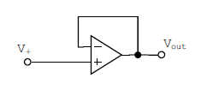

Non-inverting Amplifier
Ideally, the voltage difference
between the two terminals of
the op-amp is zero.
So
Voltage Follower Circuit: It is also known
as a unity gain amplifier, buffer amplifier or an isolation amplifier. Its main application
arises due to the fact that its input resistance is very high so that it draws
negligible current from the source.

Slide 3
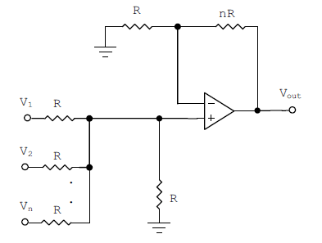


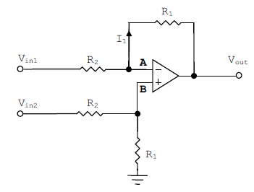




Non-inverting Summing Amplifier
The output voltage in terms of input voltages is given by,
Difference Amplifier

Slide 4

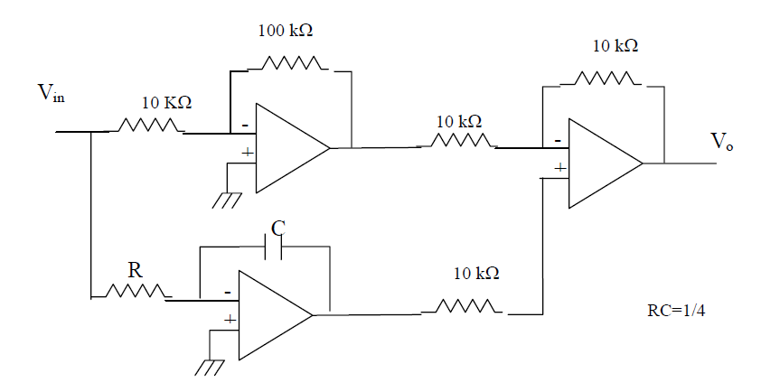
Develop a circuit to realize the following equation

